Slide 1


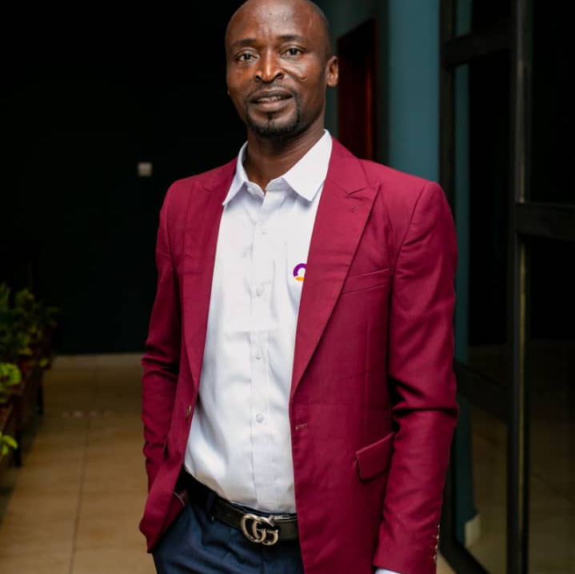
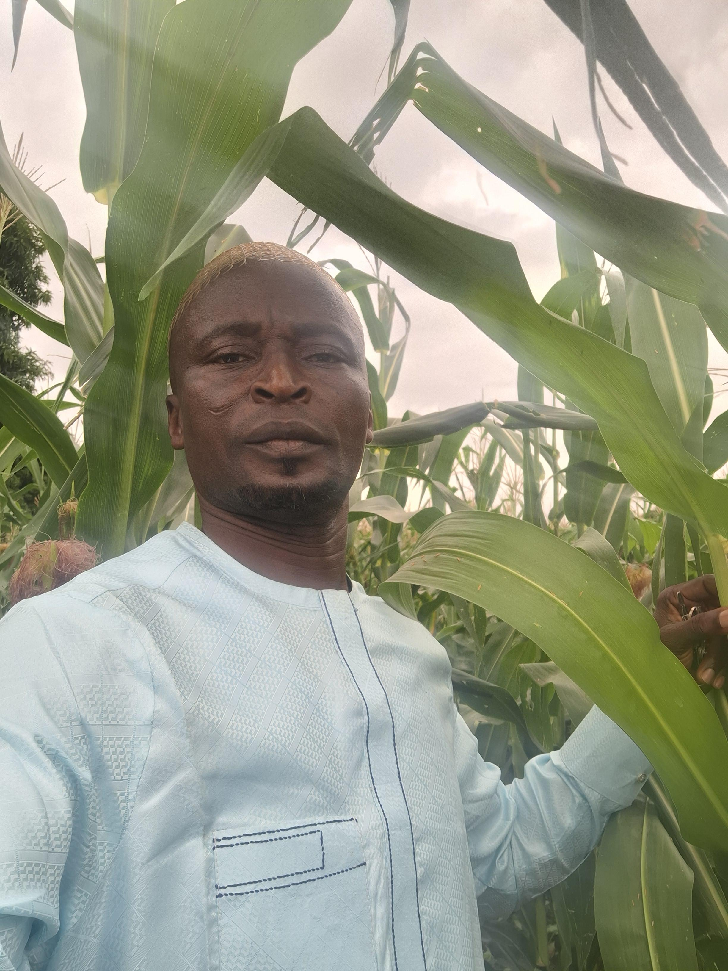
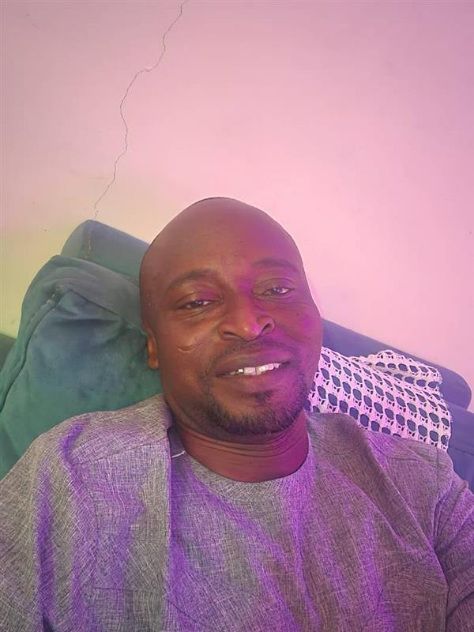
Getting to Know Me
Work
Personal
My role
Text
ZONAL HEAD
Significant others / family members / furry friends in my life
MY SPOUSE, FAMILY AND WORK
Tenure in ofi/Olam
25YEARS
How I enjoy spending my free time
FARMING
Previous companies I have worked at
OLAM
My favorite / comfort food
FUFU AND TUO ZAAFI
Why I joined ofi/Olam and what keeps me here?
TO GROW MY CAREER AND UNITY KEEPS ME HERE
My favorite song
ISLAMIC TEACHINGS
HARUNA SHAIBU
‘what name you prefer to be called’
A few fun facts about me
FOOTBALL IS THE GAME
This is me outside work, doing stuff I enjoy in my life …

